Slide 1
Solution Sketch
Lecturer: Ngo Huy Bien
Software Engineering Department
Faculty of Information Technology
VNUHCM - University of Science
Ho Chi Minh City, Vietnam
nhbien@fit.hcmus.edu.vn

Slide 2

Objectives
To create a solution sketch.

Slide 3

Contents
Solution Sketch
Dependency Injection

Slide 4

References
Dino Esposito and Andrea Saltarello (2014). Microsoft .NET - Architecting Applications for the Enterprise. Microsoft Press.
Adam Freeman (2013). Pro ASP.NET MVC 5.

Slide 5

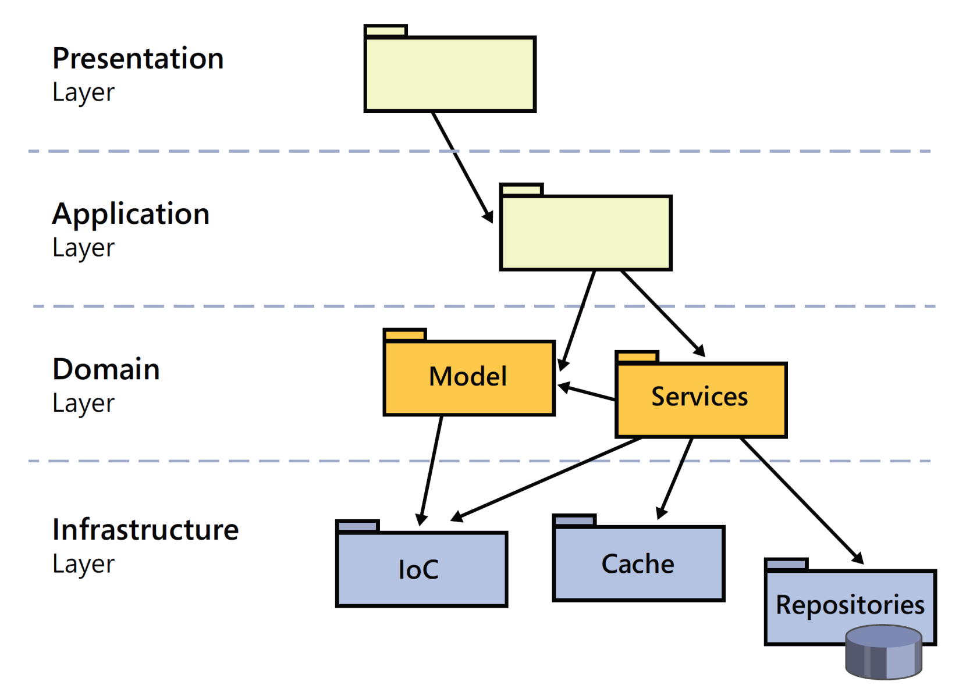


1. Design an Architecture [1]

Slide 6


2. Select Frameworks
Immature frameworks
Bugs?
Standard features support?
Documentation?
Legacy systems integration?
Legacy systems migration?
Old frameworks
New features support?
Productivity?

Slide 7
3. Create a Solution Sketch
Architecture
Frameworks
Wireframe
Creating a solution
Creating projects, folders
Specifying interdependencies
Importing libraries
Configuring compilation options
Configuring link options
Configuring build options
Constructing a Hello World

Slide 8
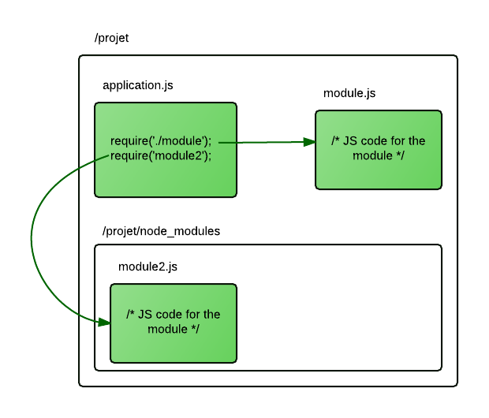
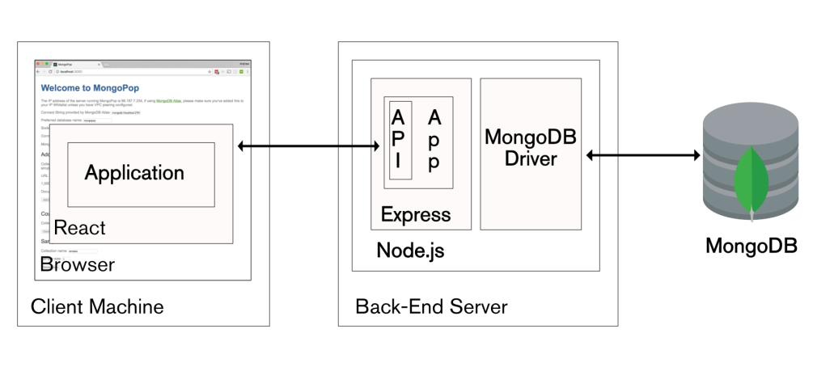
4. Define Components
What constitutes an application component (application module)?
How is an application component structured, built and used?
How will application components interact?

Slide 9
Example: Node.js Folder Structure
src
│ app.js # App entry point
└───api # Express route controllers for all the endpoints of the app
└───config # Environment variables and configuration related stuff
└───jobs # Jobs definitions for agenda.js
└───loaders # Split the startup process into modules
└───models # Database models
└───services # All the business logic is here
└───subscribers # Event handlers for async task
└───types # Type declaration files (d.ts) for Typescript

Slide 10
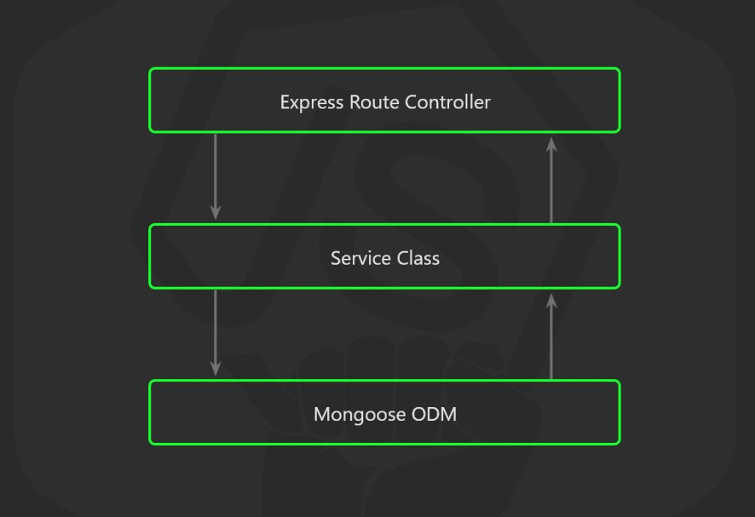
Example
Don’t put your business logic inside the controllers because as soon as you need to write unit tests, you will end up dealing with complex mocks.
Someday, you will want to use your business logic on a CLI tool, or not going far, in a recurring task.

Slide 11
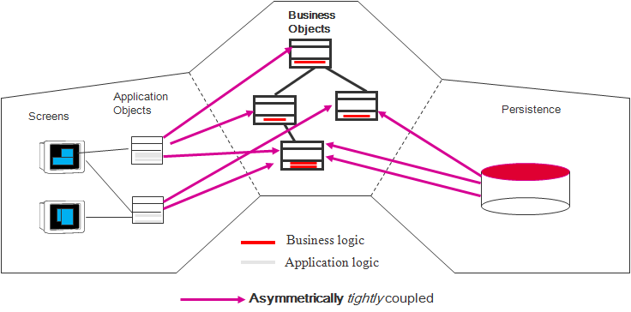
Components Dependency

Slide 12

Separation of Concerns
I want the components in my applications to be as independent as possible and to have as few interdependencies as I can arrange.
In an ideal situation, each component knows nothing about any other component and only deals with other areas of the application through abstract interfaces.
This is known as loose coupling, and it makes testing and modifying applications easier.

Slide 13
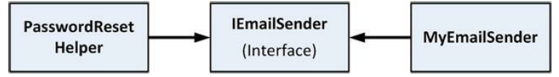
Dependency Injection Example [2]
public class PasswordResetHelper {
public void ResetPassword() {
IEmailSender mySender = new MyEmailSender();
//...call interface methods to configure e-mail details...
mySender.SendEmail();
}
}
☠ My goal is being able to replace MyEmailSender without having to change PasswordReset helper.

Slide 14
☞ Solution
What I need is a way to get objects that implement an interface without having to create the object directly.
public class PasswordResetHelper {
private IEmailSender emailSender;
public PasswordResetHelper(IEmailSender emailSenderParam) {
emailSender = emailSenderParam;
}
public void ResetPassword() {
// ...call interface methods to configure e-mail details...
emailSender.SendEmail();
}
}
...
IEmailSender sender = new MyEmailSender();
helper = new PasswordResetHelper(sender);
...

Slide 15
Dependency Injection Container
☠ How do I instantiate the concrete implementation of interfaces without creating dependencies somewhere else in the application?
☞ The answer is to use a dependency injection container, also known as an IoC container.
I register the set of interfaces or abstract types that my application uses with the DI container, and specify which implementation classes should be instantiated to satisfy dependencies.
I no longer create the objects in my application myself using the new keyword. Instead, I go to the DI container and request the objects I need.

Slide 16
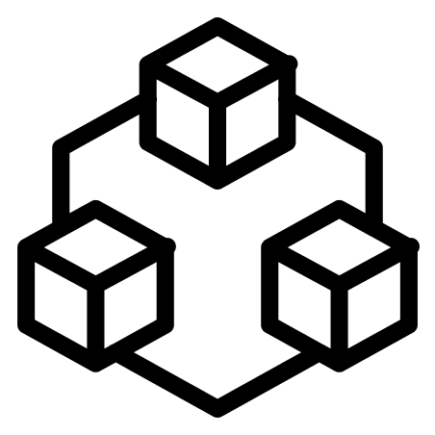

.NET Dependency Injection Tools
http://www.ninject.org/
https://structuremap.github.io/
https://github.com/unitycontainer/unity

Slide 17
Example With Ninject (I)
public class NinjectDependencyResolver : IDependencyResolver {
private IKernel kernel;
public NinjectDependencyResolver(IKernel kernelParam) {
kernel = kernelParam;
AddBindings();
}
public object GetService(Type serviceType) {
return kernel.TryGet(serviceType);
}
public IEnumerable<object> GetServices(Type serviceType) {
return kernel.GetAll(serviceType);
}
private void AddBindings() {
kernel.Bind<IEmailSender>().To<MyEmailSender>();
}
}

Slide 18
Example With Ninject (II)
Create a file called NinjectWebCommon.cs in the App_Start folder that defines methods called automatically when the application starts, in order to integrate into the ASP.NET request lifecycle.
//NinjectWebCommon.cs
...
private static void RegisterServices(IKernel kernel) {
System.Web.Mvc.DependencyResolver.SetResolver(new
NinjectDependencyResolver(kernel));
}
...

Slide 19
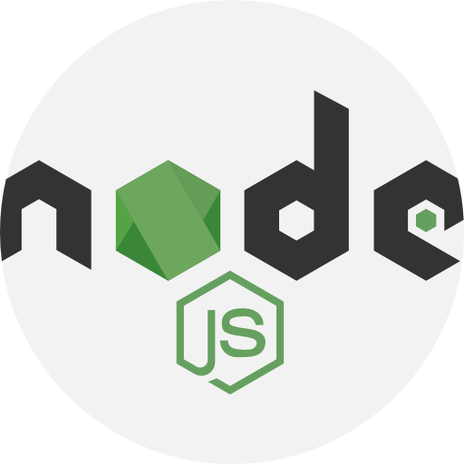
Node.js Dependency Injection Tools
https://www.npmjs.com/package/awilix
https://www.npmjs.com/package/typedi
https://inversify.io

Slide 20
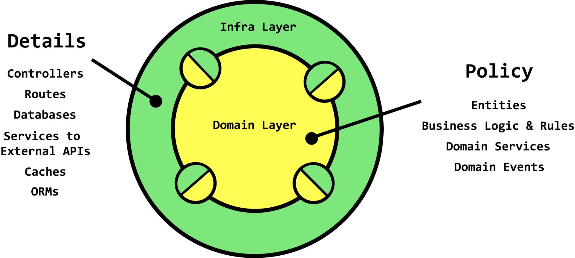

6. Verify Technology Agonistic

Slide 21

Thank You & See You Again

